Slide 1
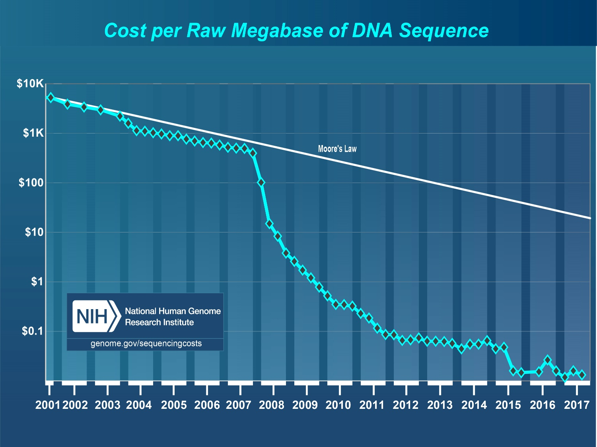
Genetic Data & Field
Brand new field
Constantly evolving
New data & new types of data released regularly, e.g UK biobank
Identified many 1000s of potential risk loci through GWAS

Slide 2
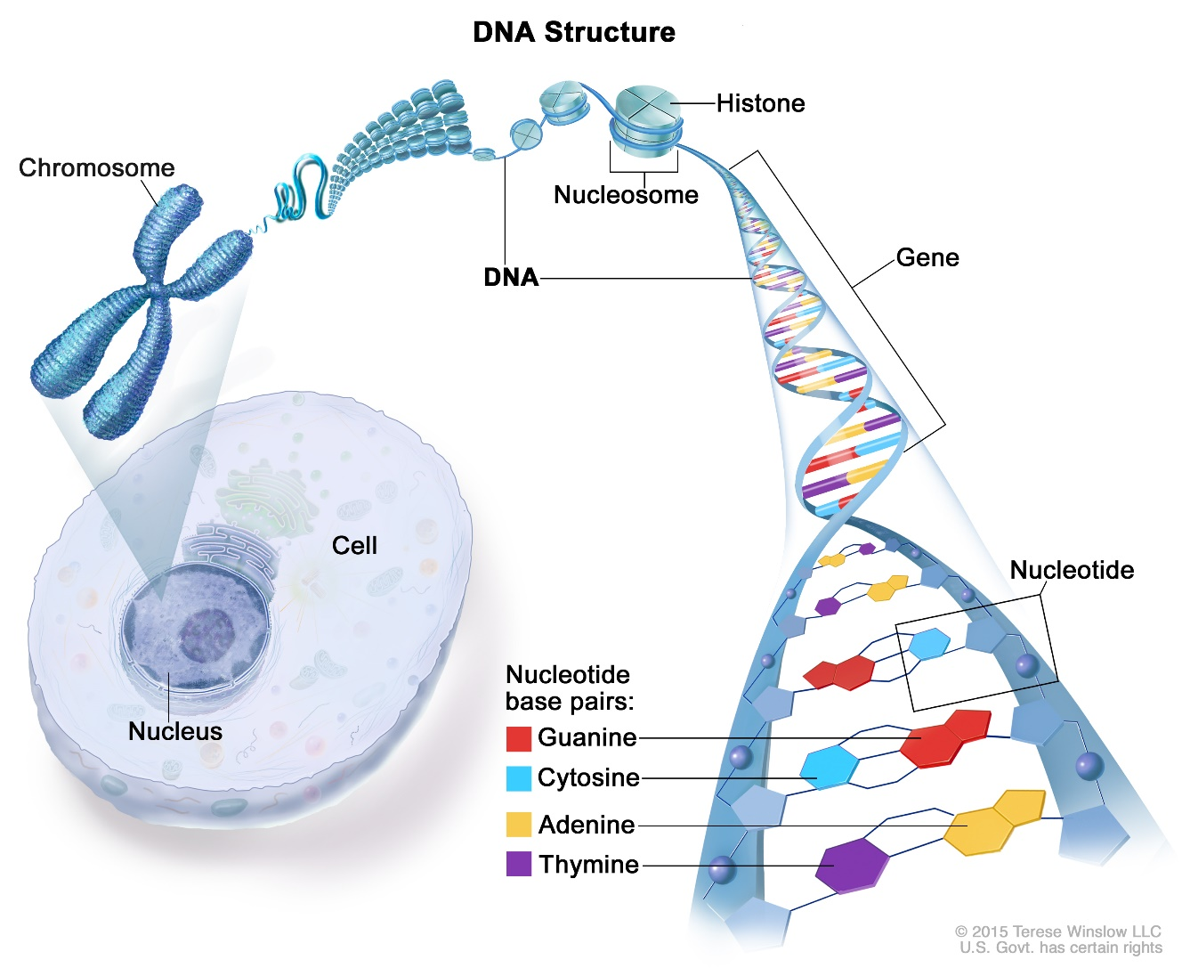
Where does the data come from?
Size: ~3.2 Billion basepairs
Divided into 22 chromosomes + sex-specific ones
Basepair has 4 values:
A, G, C, T

Slide 3
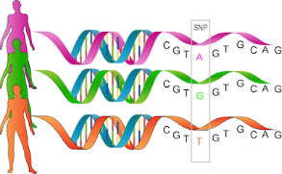
Our data – the SNP
Single-Nucleotide Polymorphism (SNP)
Large parts of the ~ 3.2 billion basepairs are identical across populations
SNPs are the deviation from a ”reference” genome
SNPs are (usually) the target of genetic analysis
E.g. 500k SNPs are genotyped, rest are imputed with a reference genome
GWAS can have many million SNPs
e.g. UK biobank has ~11 million and ~330k individuals

Slide 4
How do we use this data?
SNP is a mutation on a single basepair
Most people could have a C with a subgroup that has an A
This means C is the major allele and A is the minor allele
The minor allele is usually considered the ”risk allele”
The genetic data consists of counting how many minor alleles are present
i.e. 0, 1, or 2.

Slide 5
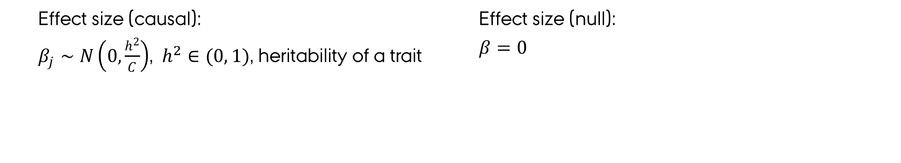
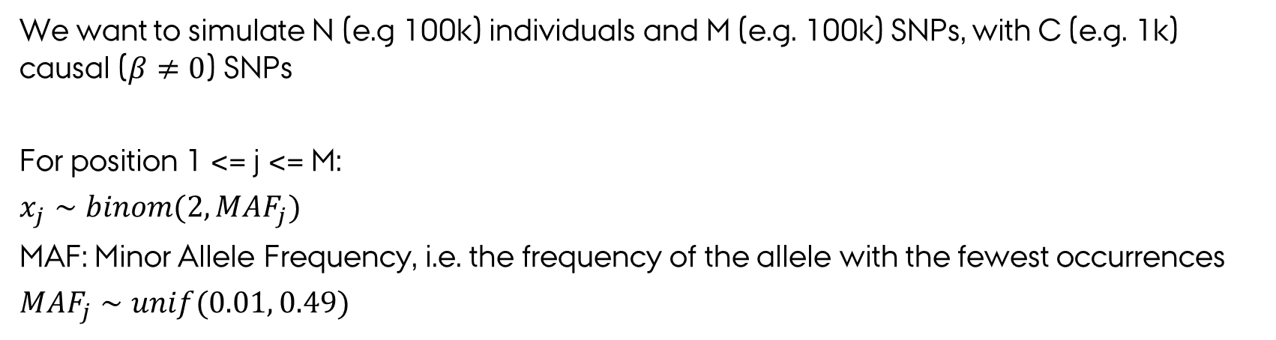
How to simulate Genotypes
We want to simulate N (e.g 100k) individuals and M (e.g. 100k) SNPs, with C (e.g. 1k) causal ($β≠0$) SNPs
For position 1 <= j <= M:
$x_{j}∼binom(2, MAF_{j})$
MAF: Minor Allele Frequency, i.e. the frequency of the allele with the fewest occurrences
$MAF_{j}∼unif(0.01, 0.49)$
Effect size (causal):
$β_{j}∼N\left(0,\frac{h^{2}}{C}\right)$, $h^{2}∈(0, 1)$, heritability of a trait
Effect size (null):
$β=0$

Slide 6
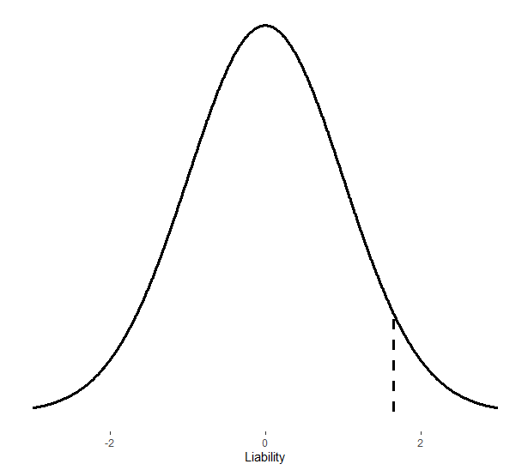
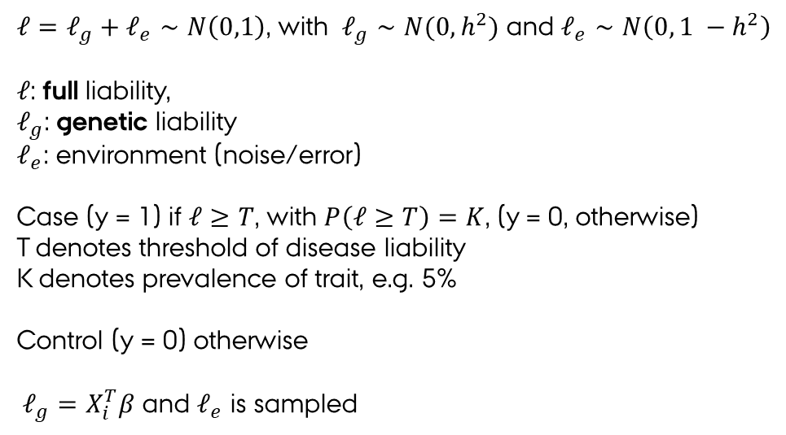
Assigning phenotypes- liability
Liability threshold model:
$ℓ=ℓ_{g}+ℓ_{e}∼N\left(0,1\right)$, with $ℓ_{g}∼N(0, h^{2})$ and $ℓ_{e}∼N\left(0, 1 −h^{2}\right)$
$ℓ$: full liability,
$ℓ_{g}$: genetic liability
$ℓ_{e}$: environment (noise/error)
Case (y = 1) if $ℓ≥T$, with $P\left(ℓ≥T\right)=K$, (y = 0, otherwise)
T denotes threshold of disease liability
K denotes prevalence of trait, e.g. 5%
Control (y = 0) otherwise
$ℓ_{g}=X_{i}^{T}β$ and $ℓ_{e}$ is sampled

Slide 7
What i envision
To get a better idea of how everything works i suggest:
Start simple!
Simulate genetic data
Consider what you want to do next – check out both options
GWAS:
Calculate Refined phenotype (GWAX, LT-FH, LT-FH++)
Requires family information
Survival analysis (SPACox)
Prediction:
What is the best prediction method we can use ?
Pretend you are a doctor and want to guess which patenients are going to get sick.

Slide 8
Questions ?
How much would you like to implement?
Implement everything yourself?
Only parts? (perhaps use PLINK for the actual GWAS calculation – highly optimized)
How familiar are you with the tidy-verse packages? E.g. ggplot2, dplyr
Do you want to use parallelization?
I suggest it due to technical limitations, e.g. RAM usage and speed
How should we meet going forward?

Slide 9
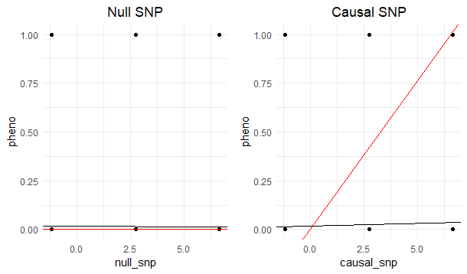
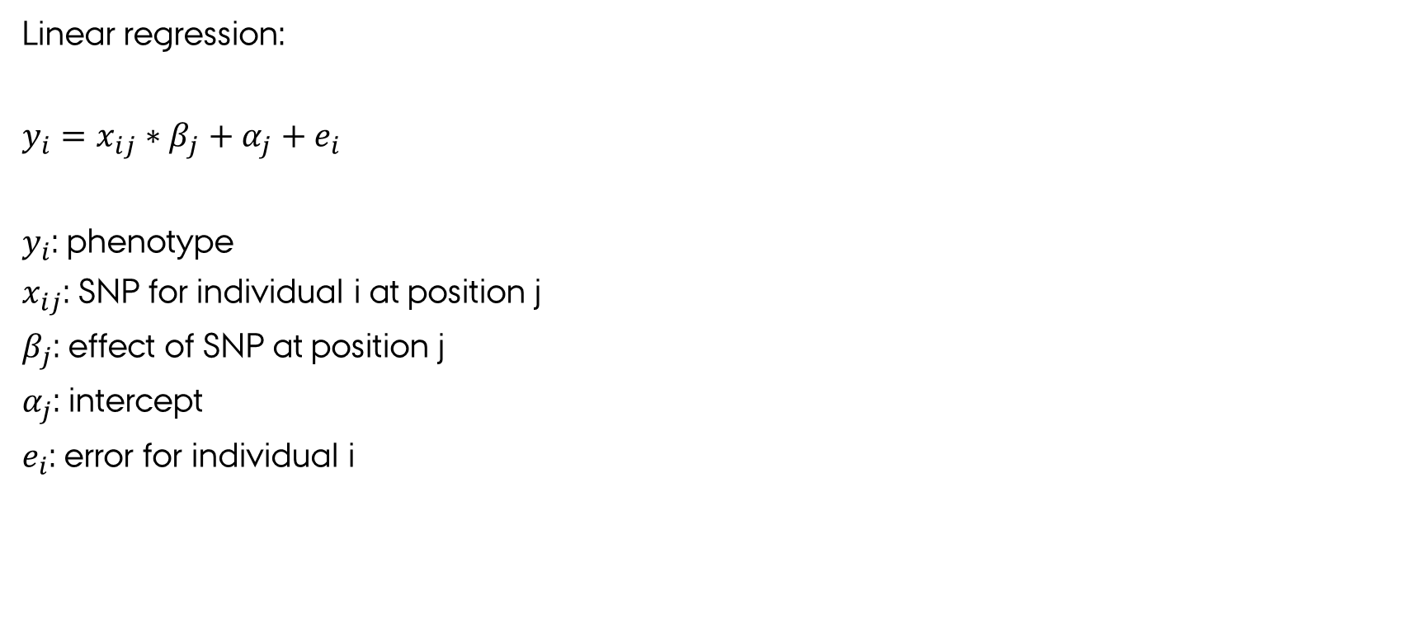
How to perform a GWAS?
Linear regression:
$y_{i}=x_{ij}∗β_{j}+α_{j}+e_{i}$
$y_{i}$: phenotype
$x_{ij}$: SNP for individual i at position j
$β_{j}$: effect of SNP at position j
$α_{j}$: intercept
$e_{i}$: error for individual i
Simulated example of GWAS
Red line: true effect Black line: estimated effect

